Slide 1
Modeling Instruction for Science Education
Preparing for the New Tennessee Science Standards

Slide 2
Modeling Instruction for Science Education
To Start:
Make a name tent with the supplies at your table. Include your name, job title/description, and school.
2. Then reflect on the following: Think about your time spent in the education field. What are three events, activities, accomplishments, collaborations, or moments of recognition by others that were shining or important to you?

Slide 3
A Little About Me:

Slide 4
Jumping Into the New Science Framework
The What
The How
The Why

Slide 5
Jumping In To The New Science Framework
The What
Will be implemented in the 2018-2019 school year
The How
Developed as a solution to the disconnected and cluttered current Tennessee science standards.
The Why
The New Science Framework was created the address the following research on scientific learning.
Reviewed in the Fall of 2016
The New Science Standards were developed to promote rigorous science instruction.

Slide 6
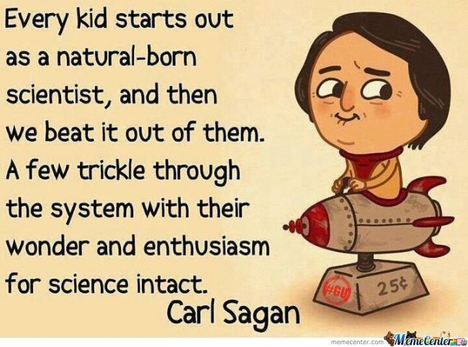
The New Science Framework
Children are born investigators.
"As children try to understand and influence the world around them, they develop ideas about their role in that world and how it works (Inagaki & Hatano, Keil, & Metz)."

Slide 7
The New Science Framework
Focusing on Core Ideas and Practices.
"The framework focuses on a limited set of core ideas in order to avoid the coverage of multiple disconnected topics - the oft mentioned mile wide and inch deep. ”
Students can develop deeper understanding!

Slide 8
The New Science Framework
Understanding Develops Over Time
"Students need sustained opportunities to work with and develop the underlying ideas and to appreciate those ideas' interconnections over a period of years rather than weeks and months."

Slide 9
The New Science Framework
Science and Engineering Require Both Knowledge and Practice
"Science is not just a body of knowledge that reflects current understanding of the world; it is also a set of practices used to establish, extend, and refine that knowledge. Both elements - knowledge and practices - are essential."

Slide 10
Structure of the Framework
" A narrow focus on content alone has the unfortunate consequence of leaving students with naive conceptions of the nature of scientific inquiry (National Research Council) and the impression that science is simply a body of isolated facts.”
Therefore, the new standards are designed to help students go deeper.

Slide 11
Activity One – States of Matter
Have you ever tried to run on dry sand? How about running on wet sand? Which is easier and why?
Use the materials put at your desk to experiment. Be ready to discuss your thoughts and sketch your conclusion.

Slide 12
Dimension 1: Practices
There are at least eight practices that are essential to scientific learning in a K-12 setting.
These were derived from the practices of scientists and engineers.

Slide 13
Dimension 1: Practices
Practice One
Asking Questions and Defining Problems
Science Asks:
What exists and what happens?
Why does it happen?
How does one know?

Slide 14
Dimension 1: Practice
Practice Two
Developing and Using Models of Scientific Phenomena
Building an understanding of models and their role in science helps students to construct and revise mental models of phenomena. Better mental models, in turn, lead to a deeper understanding of science and enhanced scientific reasoning.

Slide 15
Dimension 1: Practices
Practice Three
Planning and Carrying out Investigations
Students need opportunities to design investigations so that they may learn the importance of such decisions as what to measure, what to keep constant, and how to select the appropriate instruments.

Slide 16
Dimension 1: Practice
Practice Four
Analyzing and interpreting data

Slide 17
Dimension 1: Practice
Practice Five
Using mathematics, information, computer technology, and computational thinking during scientific investigation.

Slide 18
Dimension 1: Practice
Practice Six
Constructing explanations (for science) and designing solutions (for engineering)

Slide 19
Dimension 1: Practice
Practice Seven
Engaging in argument from evidence
Learning to argue scientifically offers students not only an opportunity to use their scientific knowledge in justifying an explanation and in identifying the weaknesses in other’s arguments, but also to build their own knowledge and understanding.

Slide 20
Dimension 1: Practice
Practice Eight
Obtaining, evaluating, and communicating information.
Any education in science and engineering needs to develop students’ ability to read and produce domain specific text.

Slide 21
Structure of the Framework: Dimension 2: Crosscutting Concepts
Crosscutting concepts are concepts that bridge disciplinary boundaries.
They hold having explanatory value throughout much of science and engineering.
These concepts help provide students with an organizational framework for connecting knowledge from the various disciplines into a coherent and scientifically based view of the world.

Slide 22
Activity Two – Static Electricity
Have you ever pulled a long piece of tape off a roll only to have the non-sticky side “stick” to your hand? Why are both sides of the tape sometimes sticky?
You will be given the supplies you need to design and implement an investigation.
Be ready to sketch and discuss your ideas.

Slide 23
Structure of the Framework: Dimension 3: Disciplinary Core Ideas
An important role of science education is not to teach “all the facts” but rather to prepare students with sufficient core knowledge so that they can later acquire additional information on their own.
- Students must be able to link current learning with core scientific disciplines.

Slide 24
Four Domains
Core Ideas were grouped in four major domains:
Physical sciences
Life sciences
Earth and Space sciences
Engineering, technology, and science applications

Slide 25
Activity Three – Potential and Kinetic Energy
If I stretch a rubber band to extend 10 cm, will it fly at the same distance as a rubber band stretched 30 cm?
Design an investigation to answer this question. Be ready to present your data and thoughts.

Slide 26
Modeling Instruction & the New Science Framework
Instruction is organized into modeling cycles rather than traditional content units.
This promotes an integrated understanding of modeling processes and the acquisition of coordinated modeling skills.

Slide 27
Modeling Instruction and the New Science Framework
Exists in two parts:
Model Development
Model Deployment

Slide 28
Model Development
Begins with a demonstration and class discussion to establish common understanding of the question to be asked of nature.
In small groups, students collaborate in planning and conducting experiments to answer or clarify the question.
Students present and justify their conclusion in oral and written form, including the formulation of a model for the phenomena in questions and an evaluation of the model by comparison with data.

Slide 29
Model Deployment
Students apply their newly-discovered model to new situations to refine and deepen their understanding.
autumnlhillis@gmail.com

