Slide 1
Implementing 3D learning through Science and Engineering Practices
TSTA Professional Learning Series:
Notes:
NOTE:
To change the image on this slide, select the picture and delete it. Then click the Pictures icon in the placeholder to insert your own image.

Slide 2
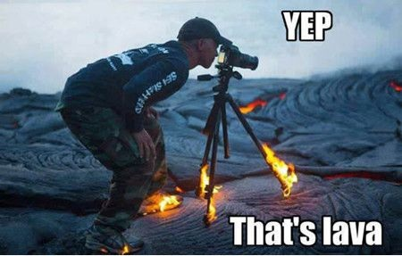
A Little About Me
Background in 4-8 middle school science
Taught 7th and 8th grade science for six years
Currently: Williamson County OER Team

Slide 3
TSTA’s Professional Learning Components
1. Designs and offers professional development opportunities for science educators.
2. Provides access to resources that support science learning and teaching
3. Inside the Science Teacher’s Studio
Explores best practice by highlighting successful instructional approaches through the lens of an interview
Provides further elaboration during a Pop-Up Conference
4. TN STEM Leadership Cadre
Thoughtful and timely professional development anchored in effective instructional practices.
Supports implementation of the K-12 Science Framework and new TN Science Standards.

Slide 4
Implementing 3D learning through the TN Science Framework
Inside the Science Teacher’s Studio and TN STEM Leadership Cadre are made possible through “Building Capacity for Tennessee Science Education” (BCTSE) a partnership between Tennessee Science Teachers Association and the Oakley STEM Center and Tennessee Tech University.

Slide 5
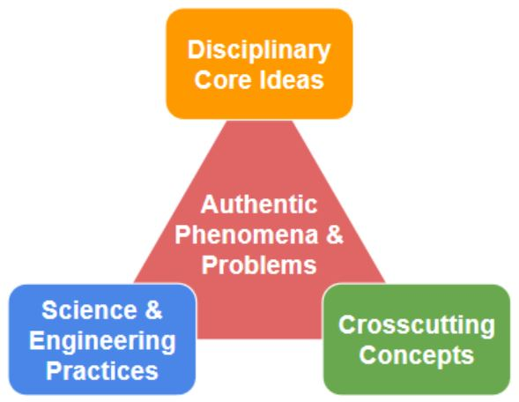
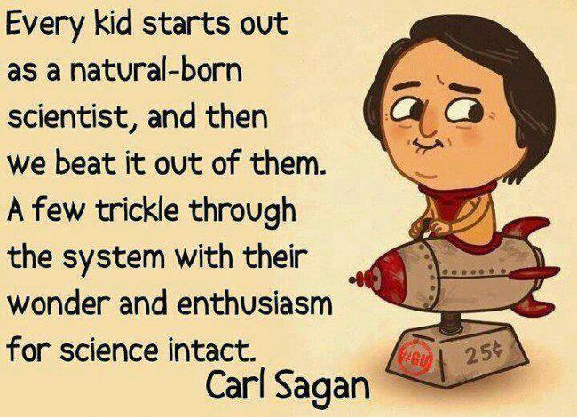
Introduction
Past view of classroom science instruction
The Change
1934 - 1996

Slide 6
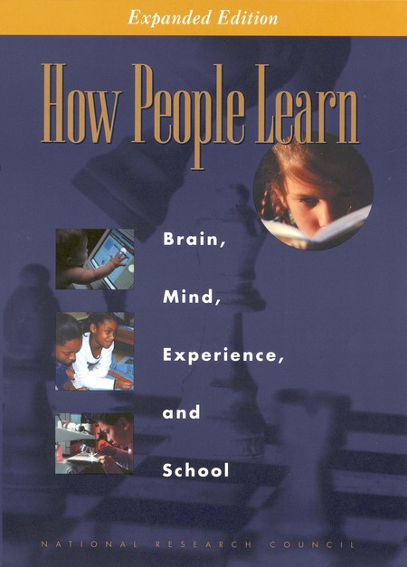
How People Learn from the National Research Council
Young children build their understanding from observations and explanations. These conclusions can be accurate or in-accurate.
When new phenomena or problems are encountered, people will seek to fit those new experiences into their preconceptions.
Only is something doesn’t fit in these “silos” will an individual build new applicable understanding.
This can lead to the “school” vs. “real world” effect. Which keeps students from applying one concept to other problems.

Slide 7
How People Learn from the National Research Council
How can teachers prevent “school” vs. “real world” learning?
Identify your student’s preconceptions.
Have them think about their own thinking.
Increase collaborative communication to give students the opportunity to refine their understanding independently.
Support with explanations and information when they are ready for it.

Slide 8
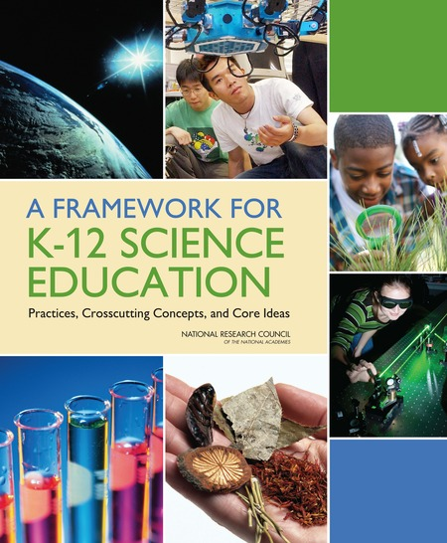
The Framework
The Framework supports our understanding that students are born investigators who acquire knowledge by integrating scientific and engineering practices, cross-cutting concepts, with core scientific ideas.
This integration provides a foundation for applying literacy and mathematical reasoning to answer questions about natural phenomena that are experienced.

Slide 9
An Analogy

Slide 10
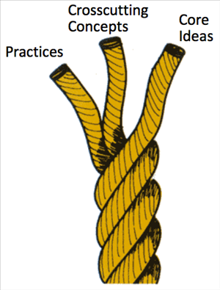
The Tennessee State Standards and the Framework for K-12 Science Education
The K-12 Framework is the foundation for our New Tennessee State Standards
The Framework is also the root of our three dimensional approach to science education.

Slide 11
Dimension One: Practices
There are at least eight practices that are essential to scientific learning in a K-12 setting.
These were derived from the practices of scientists and engineers in their professional experimentation.

Slide 12
Dimension Two: CrossCutting Concepts
Crosscutting concepts are concepts that bridge disciplinary boundaries.
They have explanatory value throughout much of science and engineering.
These concepts help provide students with an organizational framework for connecting knowledge from the various disciplines into a coherent and scientifically based view of the world.

Slide 13
Dimension Three: Disciplinary Core Ideas
An important role of science education is not to teach “all the facts” but rather to prepare students with sufficient core knowledge so that they can later acquire additional information on their own.
Students must be able to link current learning with core scientific disciplines.

Slide 14
Our Focus
Dimension One: Practices
From research completed by the National Research Council in 2001, we know that a narrow focus on content alone has the unfortunate consequence of leaving students with naïve conceptions of the nature of scientific inquiry (Drive, Millar, & Scott; 1996) and the impression that science is simply a body of isolated facts (Schwab. 1962)
We also know that students come to us with concepts they have created or integrated into their understanding of the world. These concepts may or may not be accurate.

Slide 15
We must work to incorporate as many practices as possible in the science investigations we introduce to our students.

Slide 16
Implementing Practices that Build Accurate Concepts

Slide 17
Implementation
After looking at the NGSS Science and Engineering Practices Handout. Discuss the following:
From the practices handout, what are some themes that stand out to you?
What are some successes your students might experience in working through these practices?

Slide 18
Let’s move away from the scientific method.

Slide 19
Phenomena: Thirsty Candle
MS-PS1-4 Matter and its Interactions
Develop a model that predicts and describes changes in particle motion, temperature, and state of a pure substance when thermal energy is added or removed.

Slide 20
Phenomena: Thirsty Candle Steps
Pour a small amount of the colored water into your saucer.
Place the candle in the middle of your plate in the middle of the table.
Use the matches to light your candle in the plate.
Place your glass over the candle and watch what happens.

Slide 21
Discussion
Most students will initially assume that the oxygen is being burned by the candle and is “lost”. This creates space for which the water to rise.
However, students will also say that “matter cannot be created or lost, only changed into a new substance.”
Why might this observation be disconnected from their prior knowledge? How can we help students develop a deeper understanding?

Slide 22
Taking it Further
How does this information influence life outside the classroom?
What connections can we make?

Slide 23
Taking It Further
What happens to the air in a tire during the winter months or during the summer months?
Could tires pop from increased air pressure due to heat? Can heat pop tires? How?
What Happens When Tires Get Too Hot?

Slide 24
Assessing Science and Engineering Practices
Leonard aired up his tires to the appropriate pressure on a cold day in February. The temperature was around 15 degrees Fahrenheit. Now it is July and 102 degrees Fahrenheit outside. Leonard has also been driving for several hours. Use the drawing of the tire below to show what has happened the air in Leonard’s tire from February to July.
Then, explain (using our classroom discussion and practice) what Leonard should do next. Be sure to given scientific details to explain your answer.

Slide 25
The Goal
Students think and communicate about their own understanding…first!
The teacher gets an idea of preconceptions students are bringing into the lesson…..first!
We limit the chances that students will separate classroom learning from outside phenomena.

Slide 26
Contact Information
@AutumnHillis
Website: https://autumnhillised.squarespace.com/
Email: autumnlhillis@gmail.com

